Slide 1



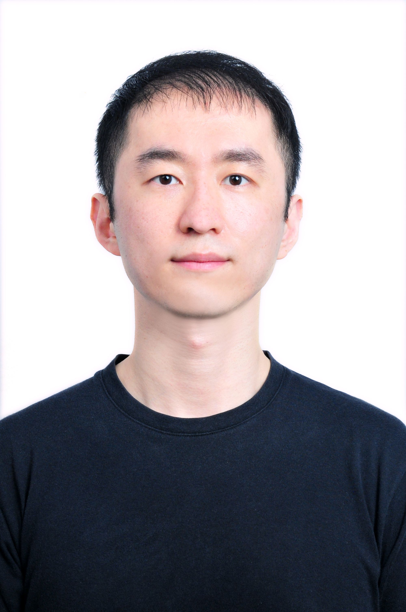

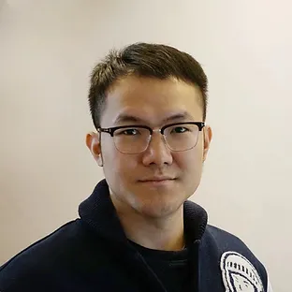


SPHERE: Mitigating the Loss of Spectral Plasticity in Mixture-of-Experts for
Deep Reinforcement Learning
Lirui Luo, Guoxi Zhang, Hongming Xu, Yaodong Yang, Cong Fang, Qing Li
Beijing Institute for General Artificial Intelligence (BIGAI)
Peking University
xxxgithun.io

Slide 2
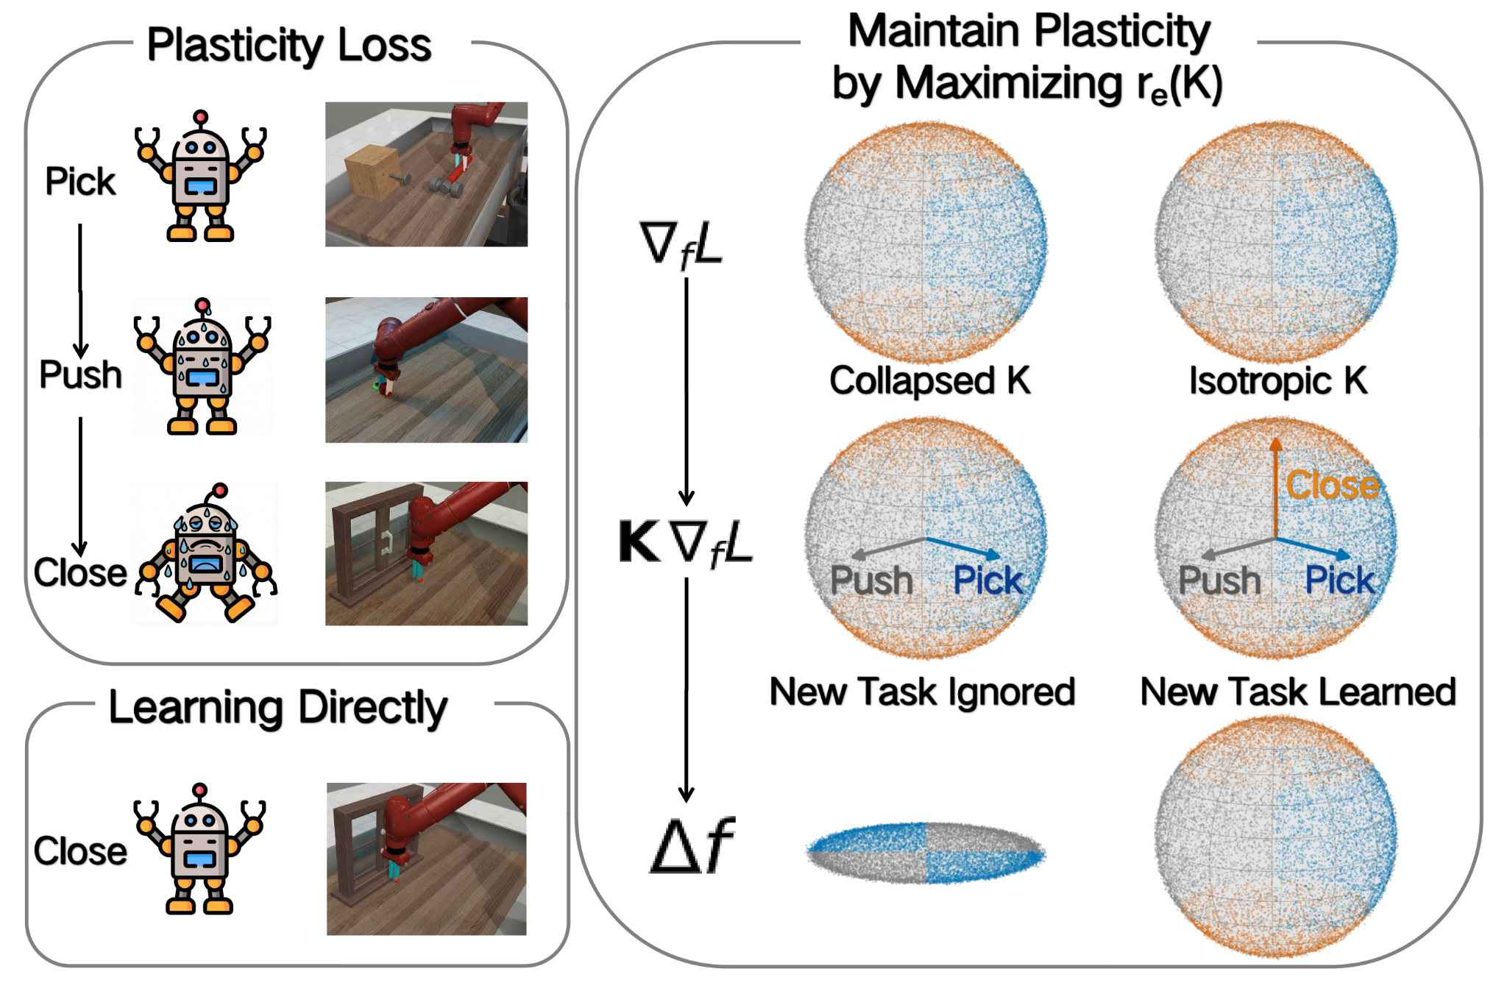
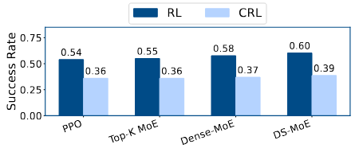
What is Plasticity Loss
Both MLP and MOE lose the ability to learn from new experiences.

Slide 3
What is the Loss of Spectral Plasticity?
Low effective rank of the empirical Neural Tangent Kernel (eNTK) restricts updates to a few directions.

Slide 4
How SPHERE Mitigating the Loss of Spectral Plasticity?
SPHERE learns from gradients in all directions.

Slide 5
How SPHERE Mitigating the Loss of Spectral Plasticity?
SPHERE learns from gradients in all directions.

Slide 6
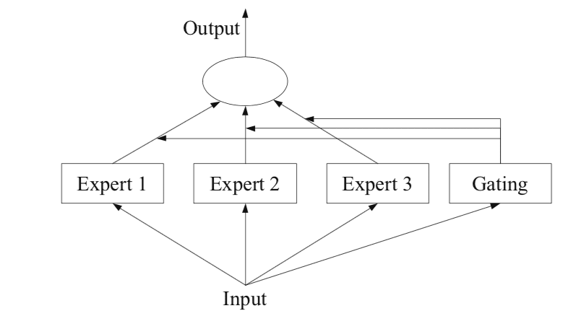
Limitation for Construct K
K = JJ⊤ ∈ R^{N ×N}
T(K)=O(N²P)
S(J)=O(NP)
When the number of parameters is large, it is almost impossible to construct K.
Get J∈ R^{N ×P} from backpropagation

Slide 7
Decompose K into smaller matrices
K = JJ⊤ ∈ R^{N ×N}
↓
G^{GN} = J⊤J ∈ R^{P ×P}
↓
A=φ⊤φ
Can be constructed from a forward pass without addition backpropagation.
φ=[feature₁*gating₁, …, feature_{n}*gating_{n}]
Expert Feature
Gating Output

Slide 8
What Does SPHERE Do?
K
↑
A
The spectrum of K is uniformized by the spectrum of uniform A.

Slide 9
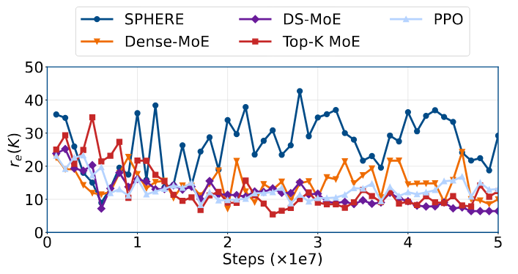
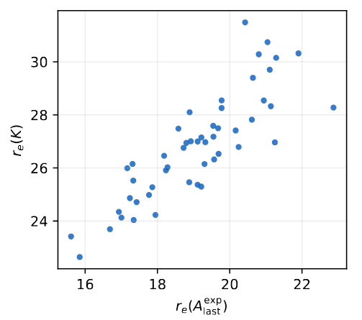
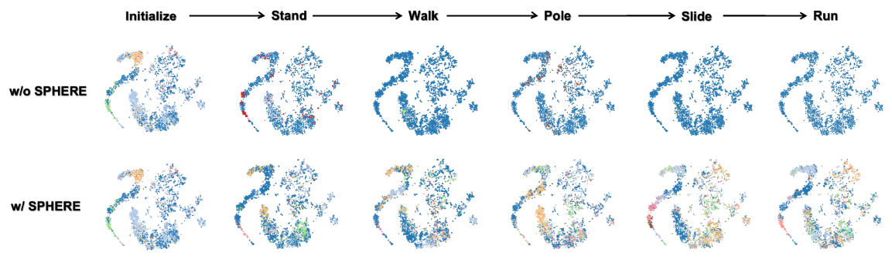
SPHERE Improves The Spectral Plasticity

Slide 10
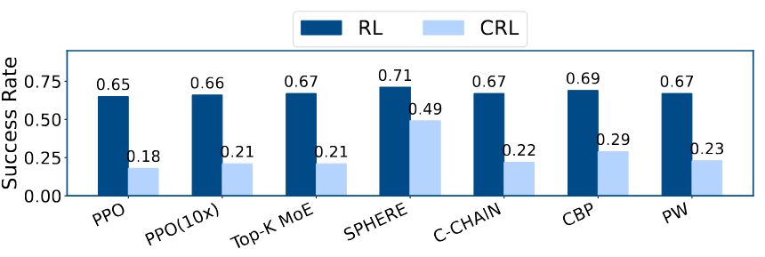
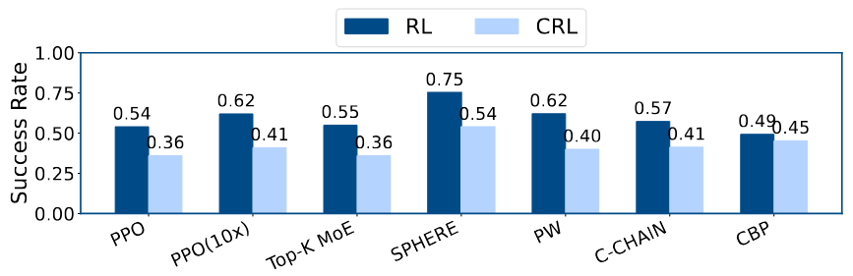
Higher Spectral Plasticity Helps Learning
Improves average suc-
cess under continual RL by 133% and 50%.

Slide 11
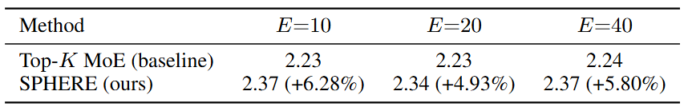
Almost No Computational Overhead
There was almost no expense regardless of the number of experts.

Slide 12

Takeaways
We formalize loss of plasticity as loss of spectral plasticity using NTK theory.
We present SPHERE, improving spectral plasticity by making the weighted expert feature spectrum uniform.
Significantly improved continual reinforcement learning performance with negligible computation overhead.
Code & demo: xxx
SPHERE: Mitigating the Loss of Spectral Plasticity in Mixture-of-Experts for
Deep Reinforcement Learning

